Slide 1
Challenges in MNLI
Haoming Jiang

Slide 2
Content
Label Noise, Label Uncertainty, and Overfitting
Conditional Language Model

Slide 3
Label Noise, Label Uncertainty, and Overfitting
Label Noise:
Training Set: 1 labeler
Dev Set: 5 labeler → well calibrated
Label Noise (% of first label ≠ calibrated label): 10%
Label Uncertainty:
Contradict | Neutral | Entail | Match | Mismatch
F | F | T | 0.221 | 0.229
F | T | F | 0.143 | 0.149
T | F | F | 0.223 | 0.231
F | T | T | 0.189 | 0.183
T | F | T | 0.043 | 0.037
T | T | F | 0.150 | 0.144
T | T | T | 0.030 | 0.028
Certain Label
~58%
Uncertain Label
~42%

Slide 4
Example
Look, there's a legend here.
See, there is a well-known hero here.
Labels: Entailment Neutral Entailment Entailment Neutral
Entailment or Neutral?
Legend = Well-known hero?

Slide 5

Motivating Experiment: Exchanging premise and hypothesis
Original Idea: Augment data by cycle consistency
$$G\left(x,y\right)=contradict⇔G\left(y,x\right)=contradict$$
$$G\left(x,y\right)=neutral⇔G\left(y,x\right)=neutral$$
$$G\left(x,y\right)=entail⇔G\left(y,x\right)=entail by$$
Results:
Augmented with the above rule: -1.3% (Baseline 84.6%)

Slide 6

Motivating Experiment: Exchanging premise and hypothesis
The cycle consistency does not hold in general
$$G\left(x,y\right)=contradict⇒G\left(y,x\right)=contradict?$$
$$G\left(x,y\right)=neutral⇒G\left(y,x\right)=neutral?$$
$$G\left(x,y\right)=entail⇒G\left(y,x\right)=?$$
Example:
The document is signed. Director signed the document. (neural)
Director signed the document. The document is signed. (entail)

Slide 7

Motivating Experiment: Exchanging premise and hypothesis
Tried more:
$contradict⇒contradict; neutral⇒neutral by;entail⇒entrail by$: -0.7%
And some other tricks trying to use the augmented data, all hurt the performance at different level.
Why? Augmented data induce more noise
We need to handle the noise in the original data & augmented data.

Slide 8
Handling Label noise and label uncertainty
1. Prompout: (84.6%)
2. MC Dropout: (85.07%)
3. Mean Teacher: (85.06%)
4. SWA : (85.06%)
5. Mean Teacher + MC Dropout: (85.24%, matched 85.49%, mis 84.98%)
…
(Baseline 84.6%)

Slide 9
Handling Label noise and label uncertainty
Questions:
How these method works?
How can we do better?

Slide 10

A unified view of calibrating the certainty
Let’s consider cross entropy loss:
$$l(x_{i},y_{i};θ)=−\log{P_{y_{i}}(x_{i};θ)}$$
Gradient Descent Direction :
$$−\frac{∂l}{∂θ}=\frac{1}{P_{y_{i}}}\frac{∂P_{y_{i}}}{∂θ}+\sum_{j≠y_{i}}{0∗\frac{∂P_{j}}{∂θ}}$$
Reward

Slide 11

A unified view of calibrating the certainty
Mean Teacher as an example:
$$θ_{t}:moving average of θ$$
Ensemble of trajectory
Loss:
$$l\left(x_{i},y_{i};θ\right)=−\log{P_{y_{i}}\left(x_{i};θ\right)}+\frac{1}{K}{\left|\left|P_{j}\left(x_{i};θ\right)−P_{j}\left(x_{i};θ_{t}\right)\right|\right|}_{2}^{2}$$
Gradient Descent Direction:
$$−\frac{∂l}{∂θ}=[\frac{1}{P_{y_{i}}}−\frac{1}{K}(P_{y_{i}}−{\tilde{P}}_{y_{i}})]\frac{∂P_{y_{i}}}{∂θ}+\sum_{j≠y_{i}}{[0−\frac{1}{K}(P_{j}−{\tilde{P}}_{j})]∗\frac{∂P_{j}}{∂θ}}$$
Reward

Slide 12



A unified view of calibrating the certainty
Reward Analysis:
$$Training Label: \frac{1}{P_{y_{i}}} − \frac{1}{K}\left(P_{y_{i}}−{\tilde{P}}_{y_{i}}\right)$$
$$Other Label: 0 − \frac{1}{K}\left(P_{j}−{\tilde{P}}_{j}\right)$$
Reward
From training data
$$R_{train}(P)$$
Calibration
From Teacher
$$R_{teach}(P,\tilde{P})$$

Slide 13
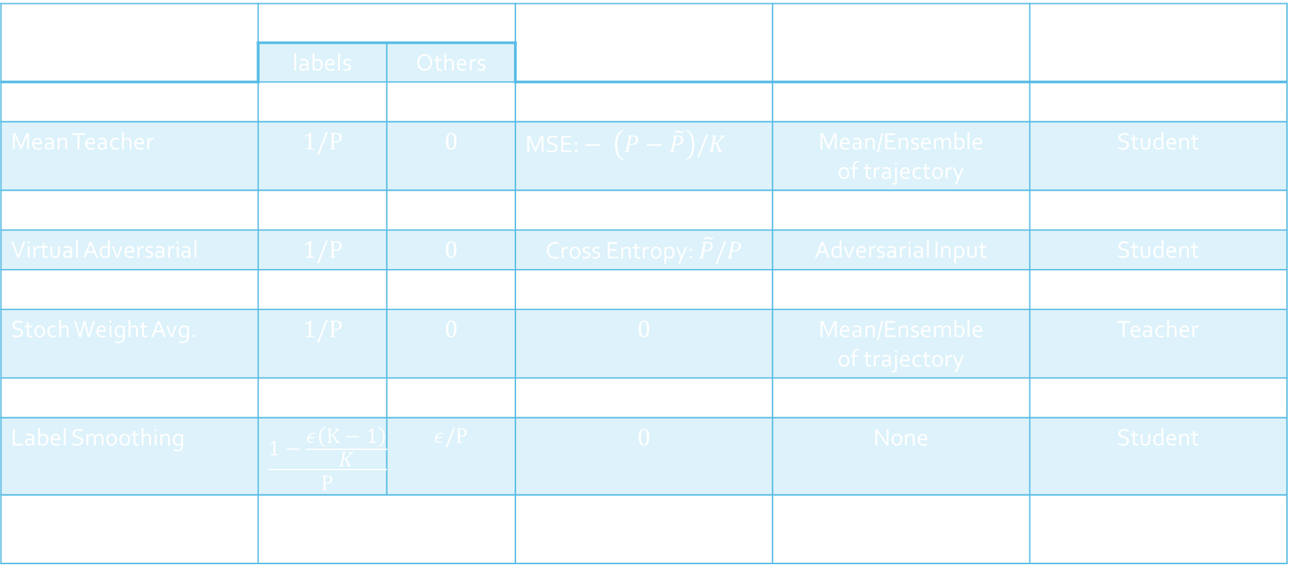
A unified view of calibrating the certainty
Method | $$R_{train}(P)$$ |  | $$R_{teach}(P,\tilde{P})$$ | Source of $\tilde{P}$ | Inference $θ$ or $θ_{t}$?
 | labels | Others
Naive | $$1/P$$ | $$0$$ | $$0$$ | None | Student
Mean Teacher | $$1/P$$ | $$0$$ | MSE: $− \left(P−\tilde{P}\right)/K$ | Mean/Ensemble of trajectory | Student
MC Dropout | $$1/P$$ | $$0$$ | $$0$$ | Dropout Ensemble | Teacher
Virtual Adversarial | $$1/P$$ | $$0$$ | Cross Entropy: $\tilde{P}/P$ | Adversarial Input | Student
Data Aug.: mixup | $$1/P$$ | $$0$$ | $\tilde{P}/P$ | Augmented Input | Student
Stoch Weight Avg. | $$1/P$$ | $$0$$ | $$0$$ | Mean/Ensemble of trajectory | Teacher
Knowledge Distill. | $$0$$ | $$0$$ | $$\tilde{P}/P$$ | Ensemble | Student/Teacher
Label Smoothing | $$\frac{1−\frac{ε\left(K−1\right)}{K}}{P}$$ | $$ε/P$$ | $$0$$ | None | Student
Prior Based: Promptout | Adjusted based on prior (updated) |  | $$0$$ | None | Student

Slide 14

A unified view of calibrating the certainty
These methods are designed for label noise, label uncertainty, adversarial attack, semi-supervised learning, domain adaptation, generalization, … , and have internal connection.
What do we learn from this view?
Directly adjust $R_{train}(P)$ based on prior is not working well, we need to calibrate based on each instance
prompout, label smoothing, …
Ensemble Teacher is useful
Knowledge distillation, mean teacher, MC dropout, adversarial training, data augmentation…

Slide 15

How can we do better?
1. Better/More ensemble/self-ensemble ($\tilde{P}$)
Borrow ideas from population learning: diverse self-ensemble
2. Better $R_{train}(P)$ $R_{teach}(P,\tilde{P})$ :
Dynamically adjust weight of each instance
3. Sampling instead of adjusting weight to accelerate training and achieving better performance.

Slide 16
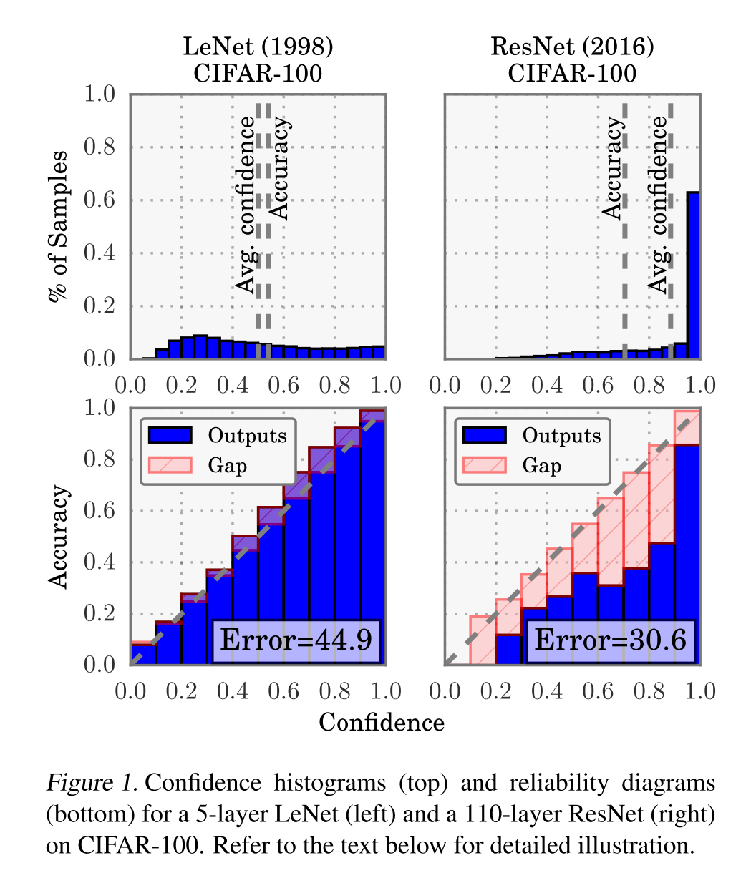
How can we do better?
Useful Observations:
Overconfidence in Deep Neural Network (C Guo et al., 2017)

Slide 17
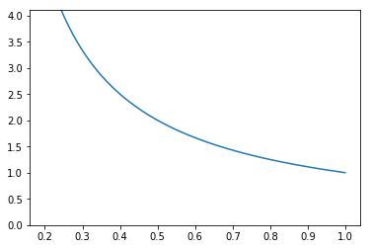
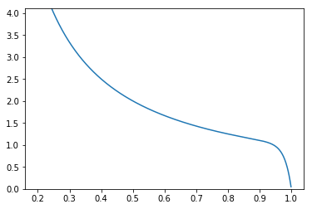


How can we do better?
Useful Observations:
Overconfidence in Deep Neural Network (C Guo et al., 2017)
$$R_{train}(P)=1/P$$
$$R_{train}\left(P\right)=\frac{1}{P}−\exp{(50\left(P−1\right))}$$
Reason:
Keep pushing
Even already
confident

Slide 18
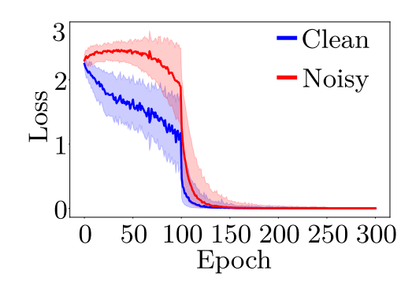
How can we do better?
Useful Observations:
Different speed of fitting easy and (hard/noise/uncertain) data (E Arazo et al., 2019)

Slide 19
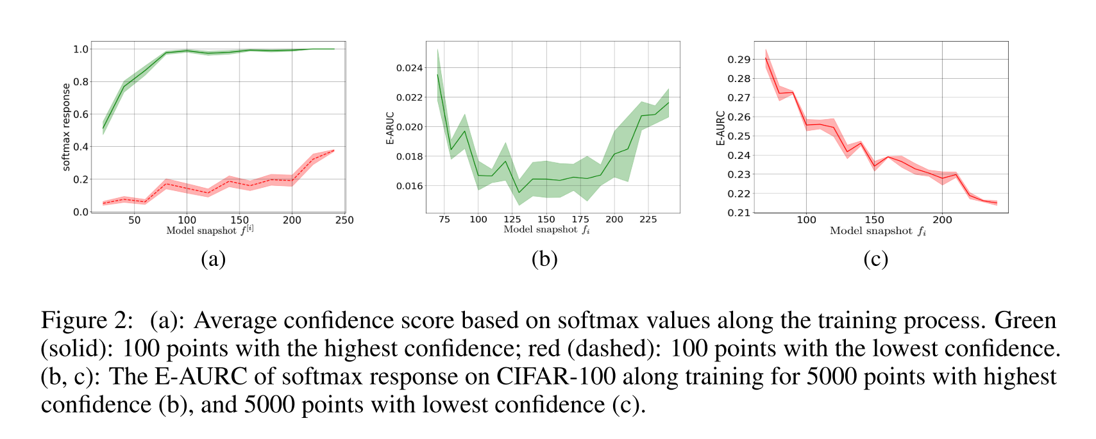
How can we do better?
Useful Observations:
Different speed of fitting easy and (hard/noise/uncertain) data
(E Arazo et al., 2019)
(Y Geifman et al., 2019)

Slide 20
How can we do better?
Useful Observations:
Different speed of fitting easy and (hard/noise/uncertain) data
How to use this observation?
Related to the trajectory ensemble: mean teacher, …
Related to curriculum learning: learn the easy sample first and hard sample latter, and maybe come back to the mis-understood samples.

Slide 21
Content
Label Noise, Label Uncertainty, and Overfitting
Conditional Language Model

Slide 22

Conditional Language Model
Recap:
Given a sentence $x$, using conditional language model generate reliable paired sentence $x′$ and label $l$ to augment training data of MNLI with $(x,x^{′},l)$

Slide 23
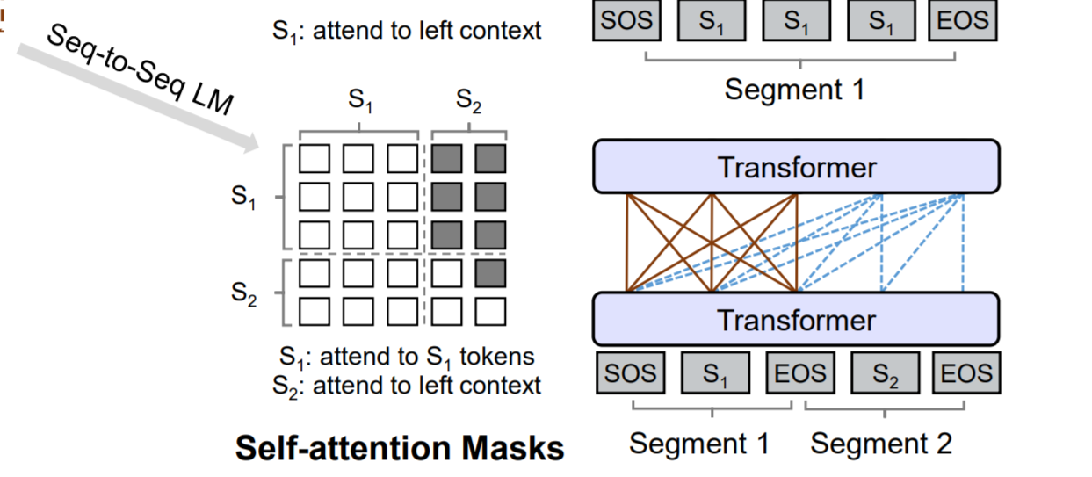
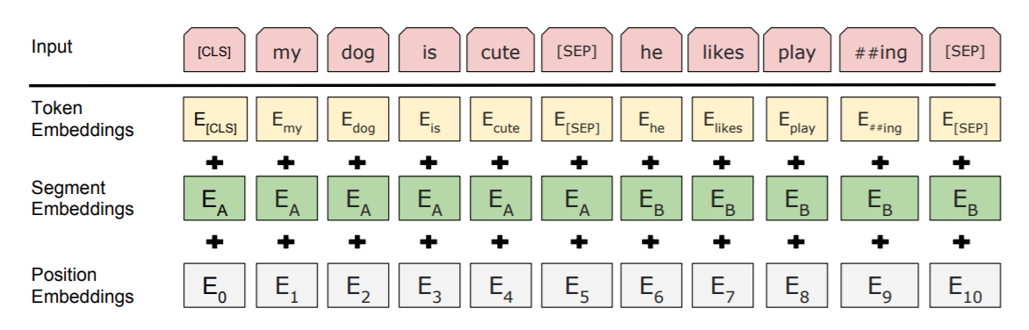
Conditional Language Model
Conditional language by masking the attention.
Model 1:
[CLS] sentence1 [SEP] sentence2 [SEP]
[Entail/Neutral/Contradict] sentence1 [SEP] sentence2 [SEP]
Model 2:
+ NLI embedding

Slide 24

Conditional Language Model
Result:
None of them attend to the condition, i.e.
$$\text{P}\text{(}\text{y}\text{|}\text{x}\text{,}\text{c}\text{=}\text{contradict}\text{)}≃\text{P}\text{(}\text{y}\text{|}\text{x}\text{,}\text{c}\text{=}\text{neutral}\text{)}≃\text{P}\text{(}\text{y}\text{|}\text{x}\text{,}\text{c}\text{=}\text{entail}\text{)}$$
Possible reason: NLI relation is too hard to be capture by simple Language Model.

Slide 25

Conditional Language Model
Possible Directions:
Integrate more supervision to help the learning of conditional language model.
Generate $x′$ from $x$ just by replacing some word in $x$
Apply random mask to $x$
$$x_{1},x_{2},x_{3},x_{4},x_{5},…⇒x_{1},[MASK],x_{3},[MASK],[MASK],x_{5},…$$
Use top k word from BERT to fill in $[MASK]$ to get $x^{′}$
Apply some filtering
Augment original data with $(x,x^{′})$
Use semi-supervised learning to learn from both labeled data and unlabeled data.

